Slide 1

How do Organisms
Reproduce?
Sexual Reproduction in flowering plants (Pollination and types of pollination)

Slide 2
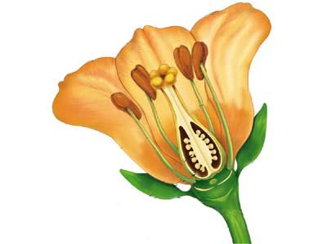
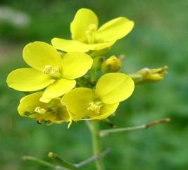
Sexual Reproduction in flowering plants
Pollination
The process of transfer of pollen grains
from anther to stigma is called
as pollination.
if this transfer occurs in the same flower
or another flower of the
same plant it is known as self pollination
Stigma
Anther

Slide 3
Sexual Reproduction in flowering plants
Pollination
If pollen is transferred from one flower
to the flower of another plant
of the same species it is known as cross pollination.

Slide 4
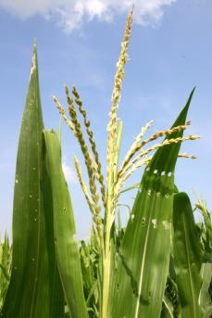
Sexual Reproduction in flowering plants
Pollination
This transfer of pollen grains can occur through
wind, insects, or other agents.
E.g. Maize plant

Slide 5
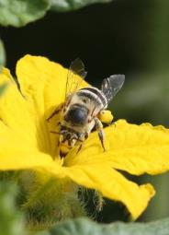
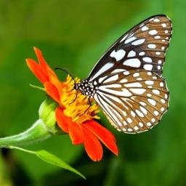
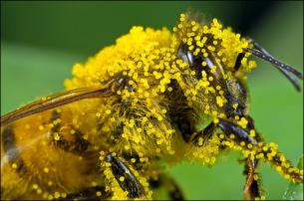
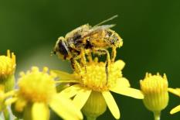
Sexual Reproduction in flowering plants
Pollination
This transfer of pollen grains can occur through
wind, insects, or other agents.
The pollen grains stick to the wings, legs and proboscis of the insects

Slide 6
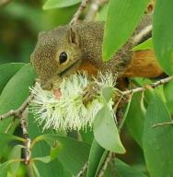
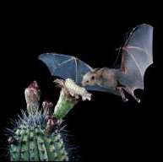
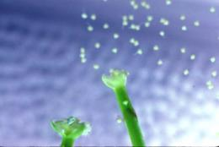
Sexual Reproduction in flowering plants
Pollination
This transfer of pollen grains can occur through
wind, insects, or other agents.
Squirrels, bats, water

Slide 7
Thank You

